Slide 1
Interfacing C++ with MATLAB
14:332:503
Programming Methodology for Finance

Slide 2
MATLAB and C++
MATLAB
  Interpreted language
    No compiling
  Great for plotting, matrix operations
  Can be slow
C++
  Compiled language
    Compiling required before running code
  Faster than MATLAB
  No easy way to plot, calculating matrices

Slide 3
Purpose
Interface C++ with MATLAB
  Use C++ for calculations
  Use MATLAB for matrix operations, plotting
C++ programs that can plot without complex codes
MATLAB scripts with faster calculations
What will we do?
  Send data from C++ to MATLAB
  Call MATLAB functions from C++

Slide 4
Setup
Demo uses Visual Studio 2010 and MATLAB R2010a on 32-bit computers
Including MATLAB Directory (after creating project and source file)
  Right click source file, select Properties
  Select Configuration Properties → C/C++ → General → Additional Include Directories
  Add “C:\Program Files\MATLAB\R2010a\extern\include” to list
Including Directory Path
  Linker → General → Additional Library Directories
  Add “C:\Program Files\MATLAB\R2010a\extern\lib\ win32\microsoft”

Slide 5
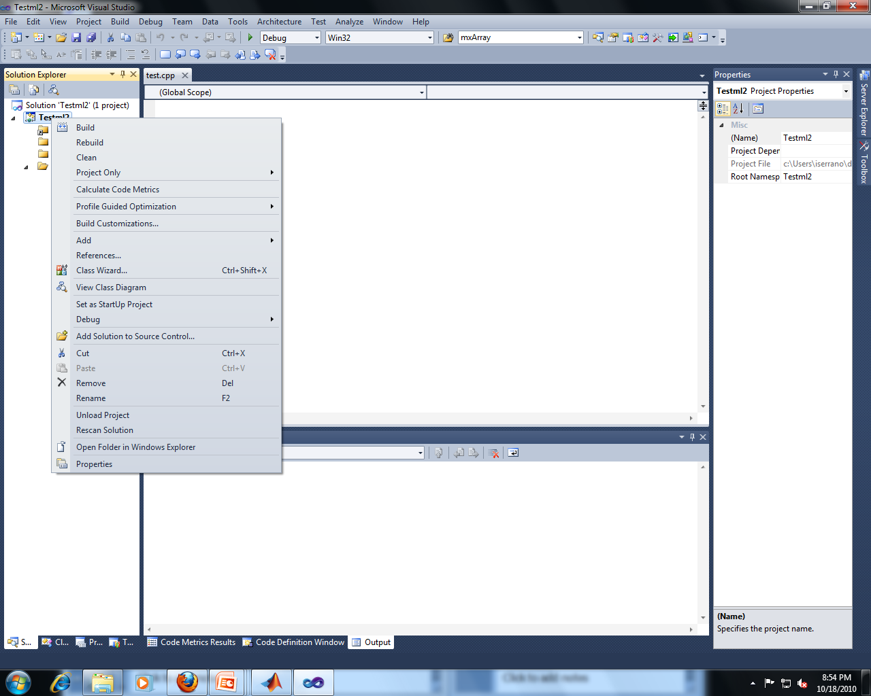

Slide 6
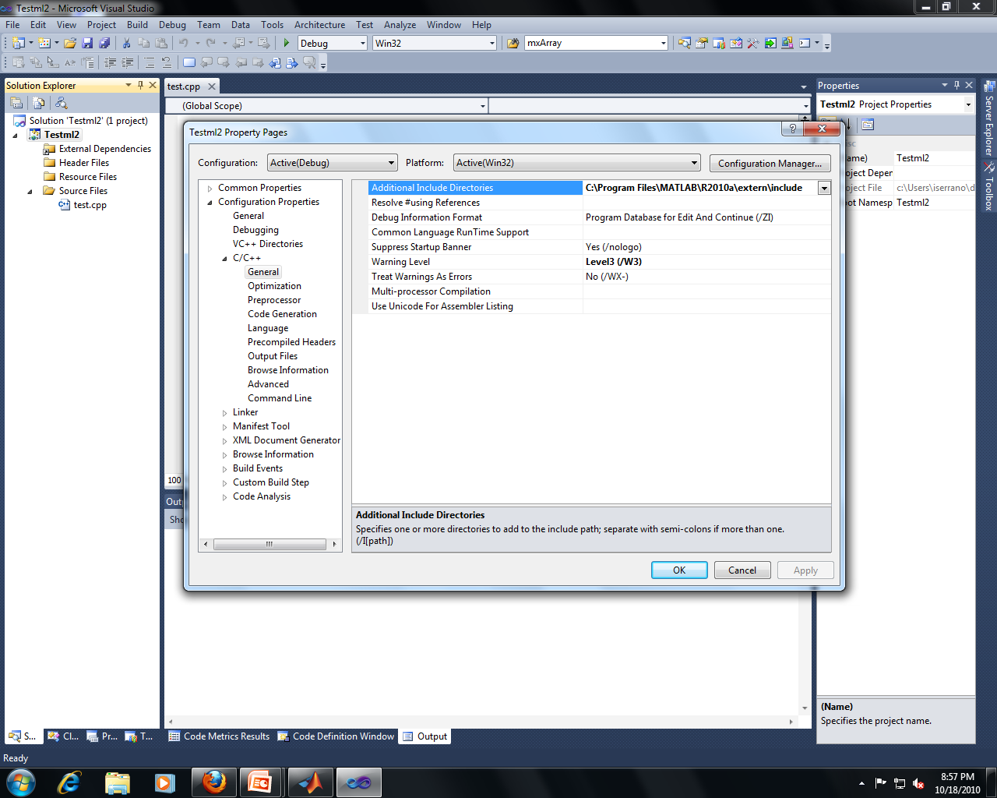

Slide 7
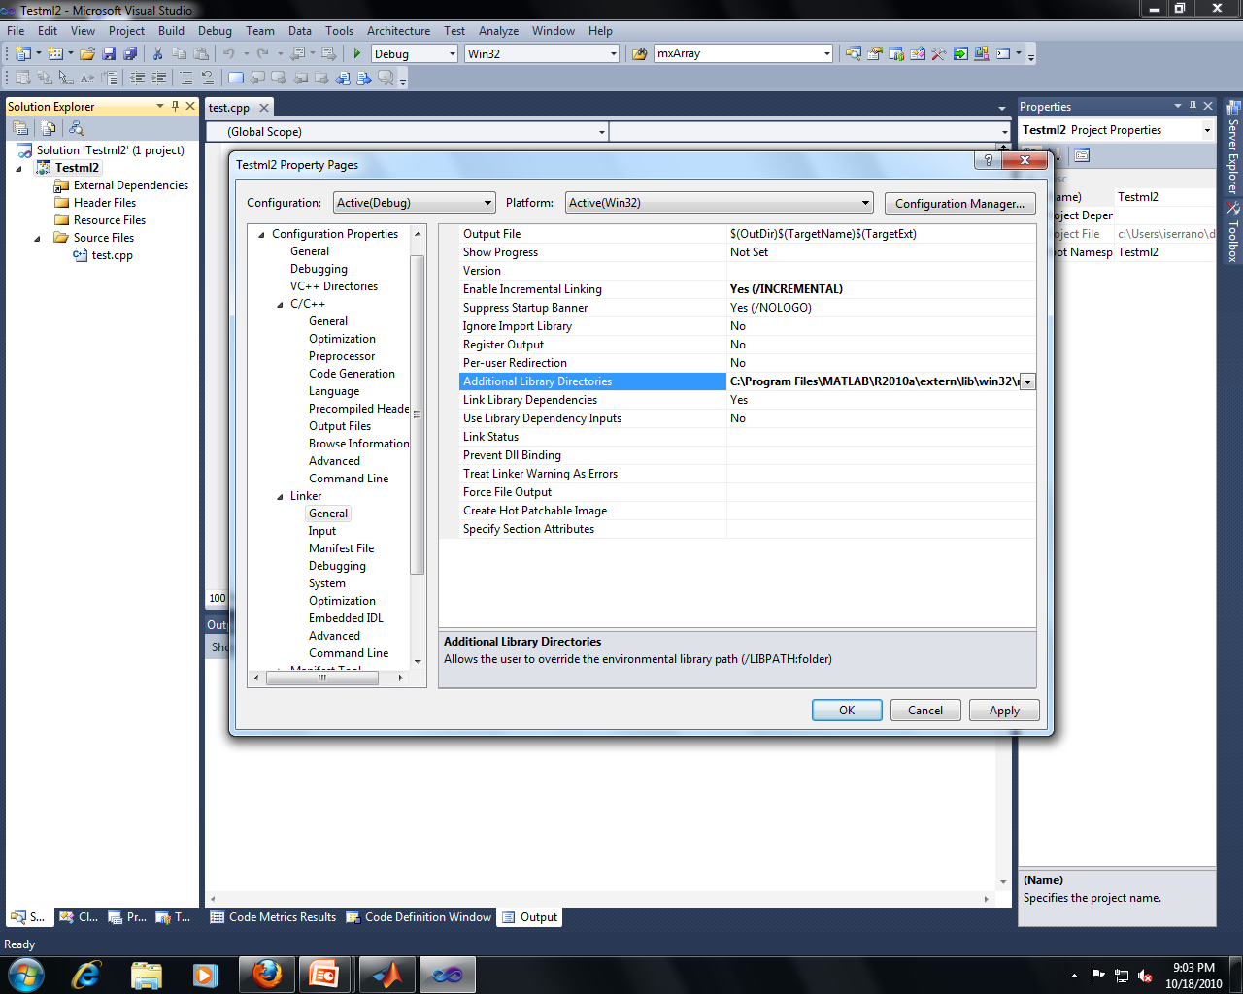

Slide 8
Setup (con’t)
Two ways of including library files:
  Linker → Input → Additional Dependencies
  Add the three files:
  - libmx.lib
  - libmex.lib
  - libeng.lib
  Add the following under the includes in the source code:
  #pragma comment( lib, “libmx.lib” )
  #pragma comment( lib, “libmex.lib” )
  #pragma comment( lib, “libeng.lib” )

Slide 9
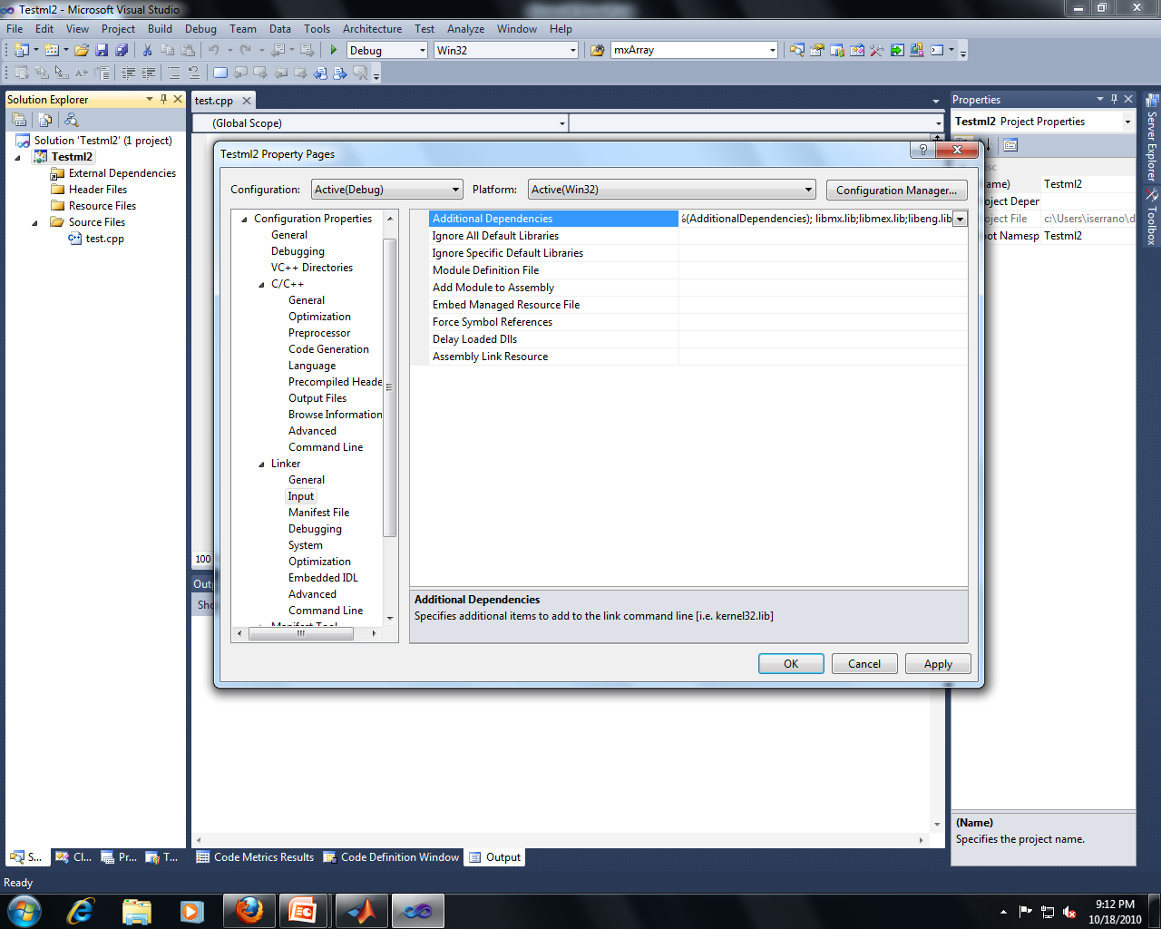

Slide 10
Setup (con’t)
One more thing…
  Start Menu → (Right click) Computer → Properties → Advanced system settings → Environment Variables… → New…
  Variable name: Path
  Variable value: C:\Program Files\MATLAB\R2010a\bin\win32

Slide 11
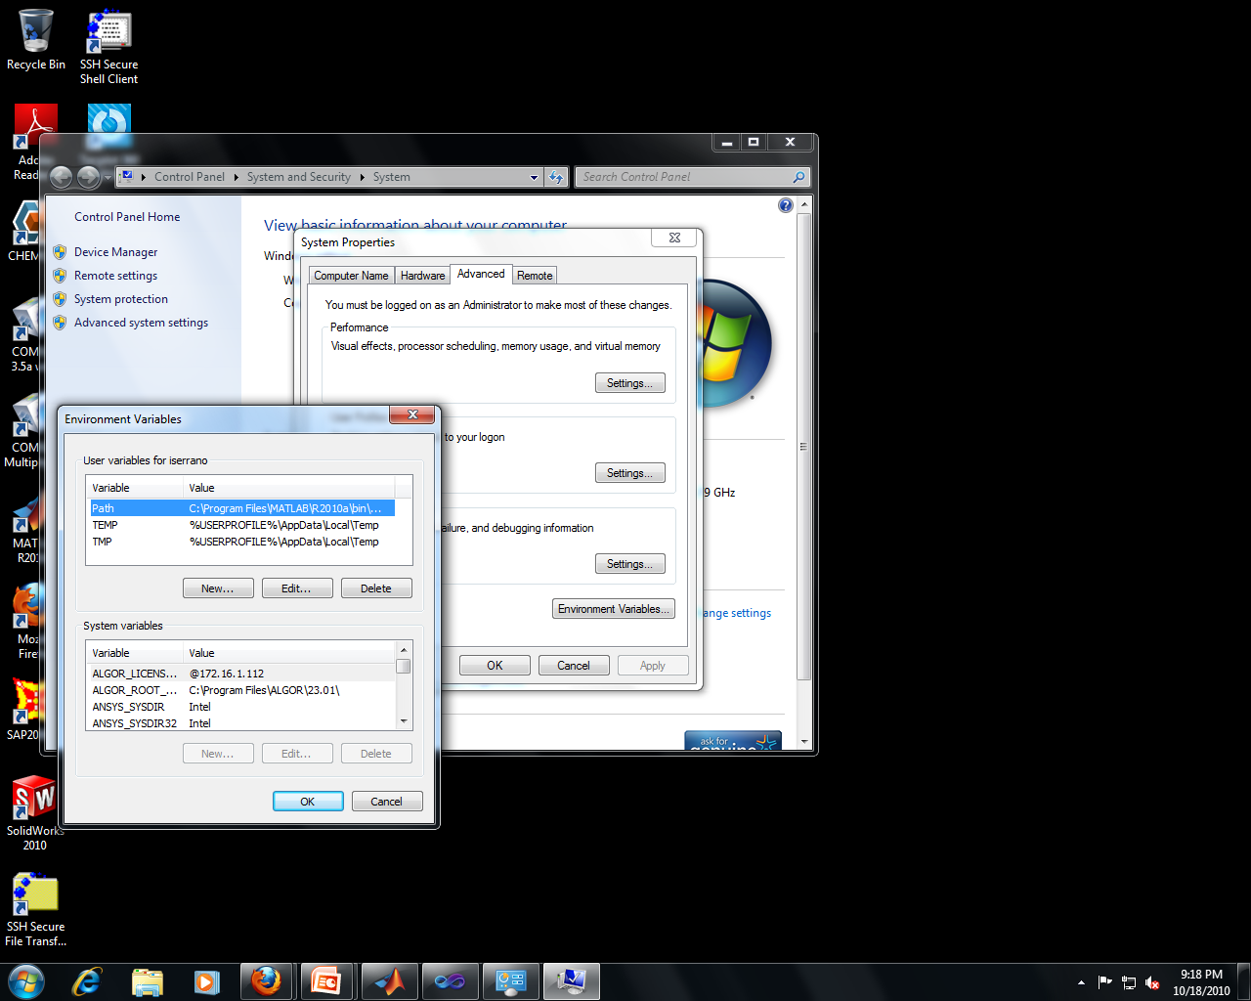

Slide 12
MATLAB and VS2010
Add the following code above the includes to make code work on VS2010:
#include <yvals.h>
#if (_MSC_VER >= 1600)
#define __STDC_UTF_16__
#endif
#include "mex.h"

Slide 13
Connecting to the MATLAB Engine
Header: #include <engine.h>
In the program, create a pointer to it:
Engine *ep;
ep = engOpen(NULL);
if (ep == NULL)
{
cout << "Error: Not Found”
<< endl;
exit(1);
}

Slide 14
I/O between C++ and MATLAB
Use the “matrix array” mxArray data type
Every variable in MATLAB is a matrix – for C++ to exchange data with it, a data type that both C++ and MATLAB recognize is needed
mxArray can “bundle” C++ variables as matrices, so both platforms recognize this data type

Slide 15
Inserting Values (Input)
To pass a variable, eg. x[0], into MATLAB, create an mxArray for it
  Allocate the space (mxCreateDoubleMatrix)
  Copy the value (memcpy)
  Name the variable in the Engine (engPutVariable)

Slide 16
Inserting Values (con’t)
double x[0];
mxArray *m_X;
m_X=mxCreateDoubleMatrix(1, 1, mxREAL);
memcpy((void *)mxGetPr(m_X), (void *)x, sizeof(double)*1);
engPutVariable(ep, "x", m_X);
Pointer ep is used to specify the engine
Variable x in the MATLAB Engine gets the value of x[0] in C++

Slide 17
Passing Arrays
To pass arrays (vector), adjust the size parameters of the memory allocation and copy routine to match the dimensions of the array being passed
Pass a vector a of dimensions: 1 x SIZE
  double a[SIZE];
  mxArray *A;
  // assume a gets initialized, all values
  A=mxCreateDoubleMatrix(1, SIZE, mxREAL);
  memcpy((void *)mxGetPr(A), (void *)a, sizeof(double)*SIZE);
  engPutVariable(ep, "a", A);
Copies entire C++ array A into the MATLAB Engine’s a

Slide 18
Passing Matrices
Pass a matrix of dimensions: SIZE x SIZE
  double c[SIZE][SIZE];
  // assume c gets initialized, all of it
  mxArray *mxc;
  mxc = mxCreateDoubleMatrix(SIZE, SIZE, mxREAL);
  memcpy((void *) mxGetPr(mxc), (void *)c, sizeof(double)*SIZE*SIZE);
  engPutVariable(ep, "c", mxc);
Note: C++ has row-major storage, and MATLAB has column-major storage. Thus a matrix being exchanged must be transposed, either before or after the exchange, to maintain the matrix’s semantics

Slide 19
Invoking Commands
engEvalString(Engine* ptr, string cmd);
  engEvalString(ep, “x = 1:1:10);“ );
  engEvalString(ep, “y = x.^2;“ );
  engEvalString(ep, “plot(x,y);“ );
Enables programmer to invoke any command in MATLAB from the C++ platform

Slide 20
MATLAB functions
A = [1, 2, 3 ; 4 ,5 ,6 ; 7 ,8 ,9];
  Creates 3x3 matrix, sets it to A (case-sensitive)
  Index starts at 1, NOT 0
x = 1:1:10;
  Creates a 1-row, 10-column array
  Numbering from 1 to 10
    First number is the first element of the array
    Second number is the increment
      In this example, x = 1:10; also gives the same answer
    Third number is the last element
sin(x), cos(x), abs(x), log(x), log10(x), exp(x)

Slide 21
MATLAB Functions (con’t)
y = A^2;
  Multiplies A with A
    ERROR when # of rows does not equal # of columns
Y = A.^2;
  Element-wise operation : Squares each element
max(x),min(x)
  Max/Min of each column
length(x)
A_transpose = A’;
A_inverse = inv(A);

Slide 22
Plotting in MATLAB
plot(X, Y);
  Plots each y element with its corresponding x element
  Line plot
plot(X,Y,’b*’);
  Same as above, but now dot plot
  Dots are blue asterisks
xlabel(‘X-Axis’), ylabel(‘Y-Axis’), title(‘Title’)

Slide 23
Extracting Values
To extract the MATLAB Engine’s variable z, pull it into C++ as a mxArray matrix, then extract the bundled value out of that mxArray and into a C++ variable
  double *cresult;
  mxArray *mresult;
  mresult = engGetVariable(ep,“z");
  cresult = mxGetPr(mresult);
  cout << cresult[0];
mxGetPr returns a pointer to a copy of the double value z stored in the MATLAB Engine
Warning: Unpredictable fatal errors occur if the data type in MATLAB doesn’t closely resemble the data type in C++ eg. Copying a 3x1 vector into a scalar

